Slide 1
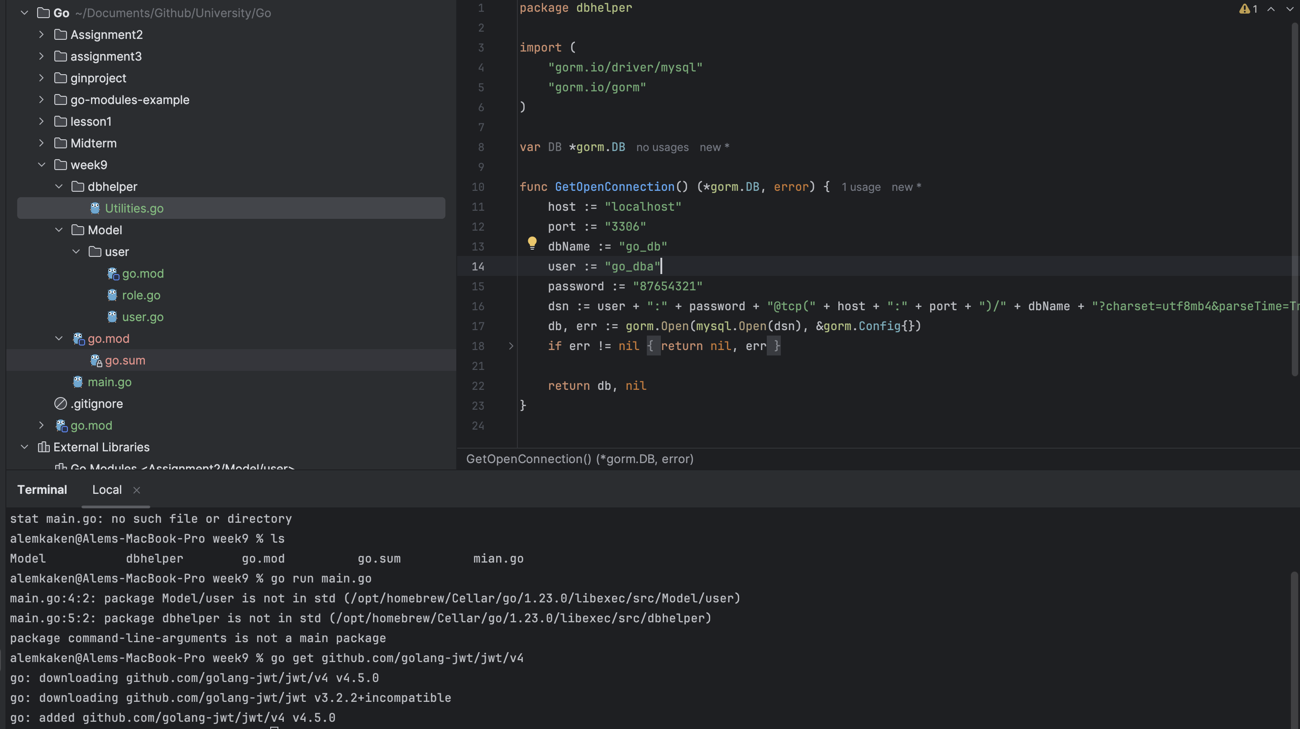
This is my logic for connecting to Databa ses. I use this method to connect to Databeses using gorm.

Slide 2
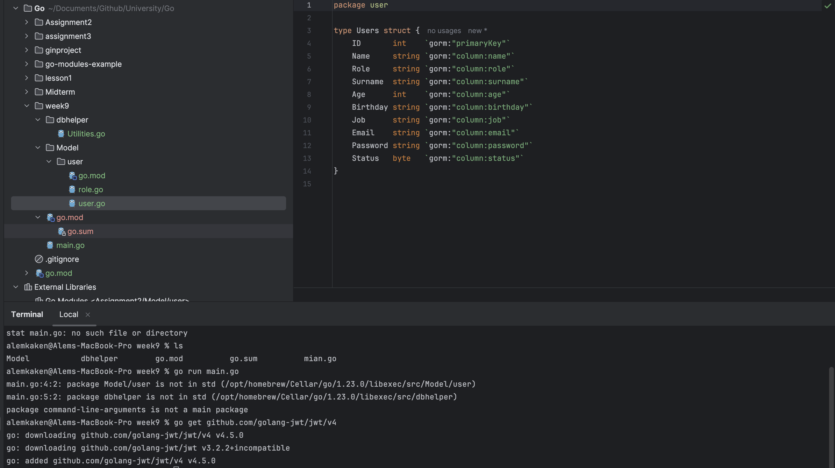
This my user model

Slide 3
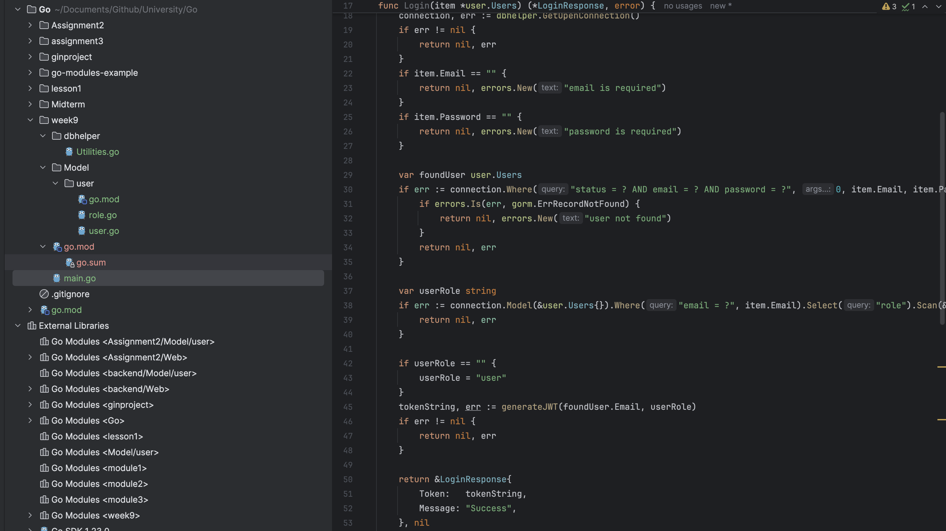
This is my login logic, checking email and password. If the user exists in the database, I check his role.

Slide 4
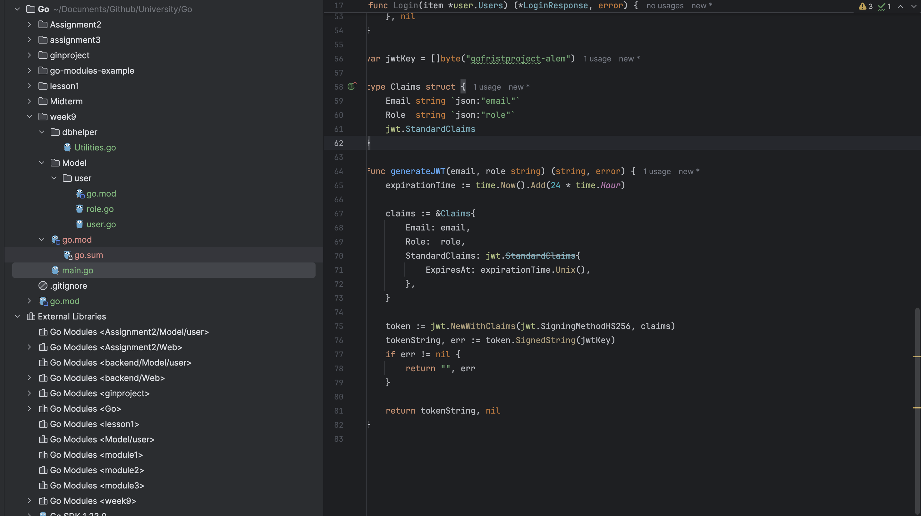
This is me checking the role, saving it with jwt, sending the role to the front end, which parses jwt, analyzes the role and decides what operations the user can do next.

Slide 5
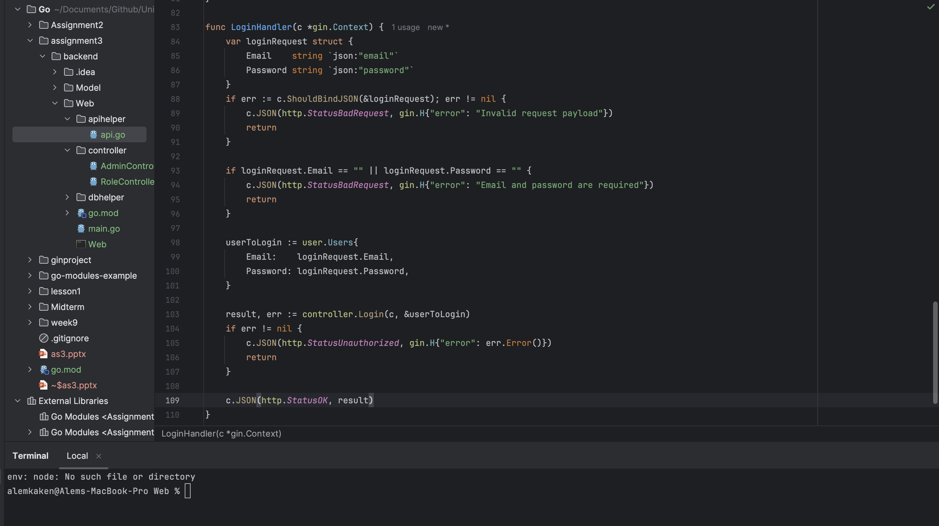
This is my page that combines the login method and the API.

Slide 6
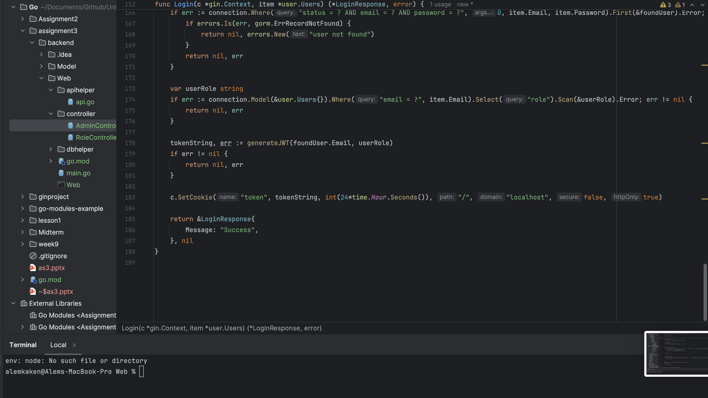
This is how the user is saved in the cookie after successfully logging in, which will help with queries and reduce databases requests

Slide 7
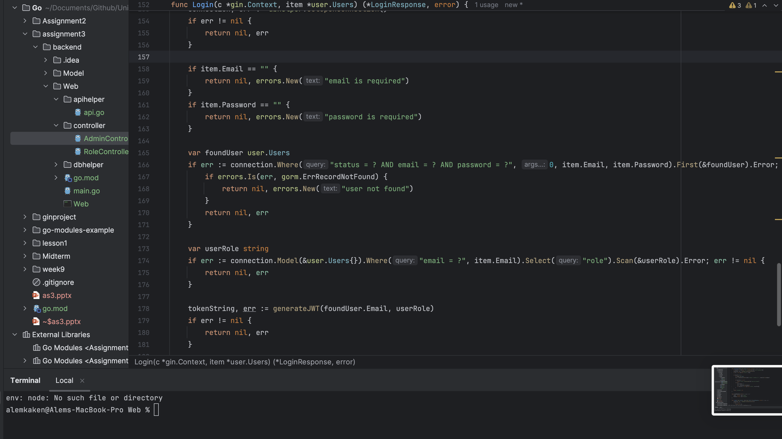
After successful login, add the admin role and send it to the front end. JWTs can be signed using a secret (HMAC algorithm) or a public/private key pair (RSA or ECDSA), ensuring the integrity and authenticity of the token. This makes it difficult for unauthorized parties to tamper with or forge tokens.

Slide 8
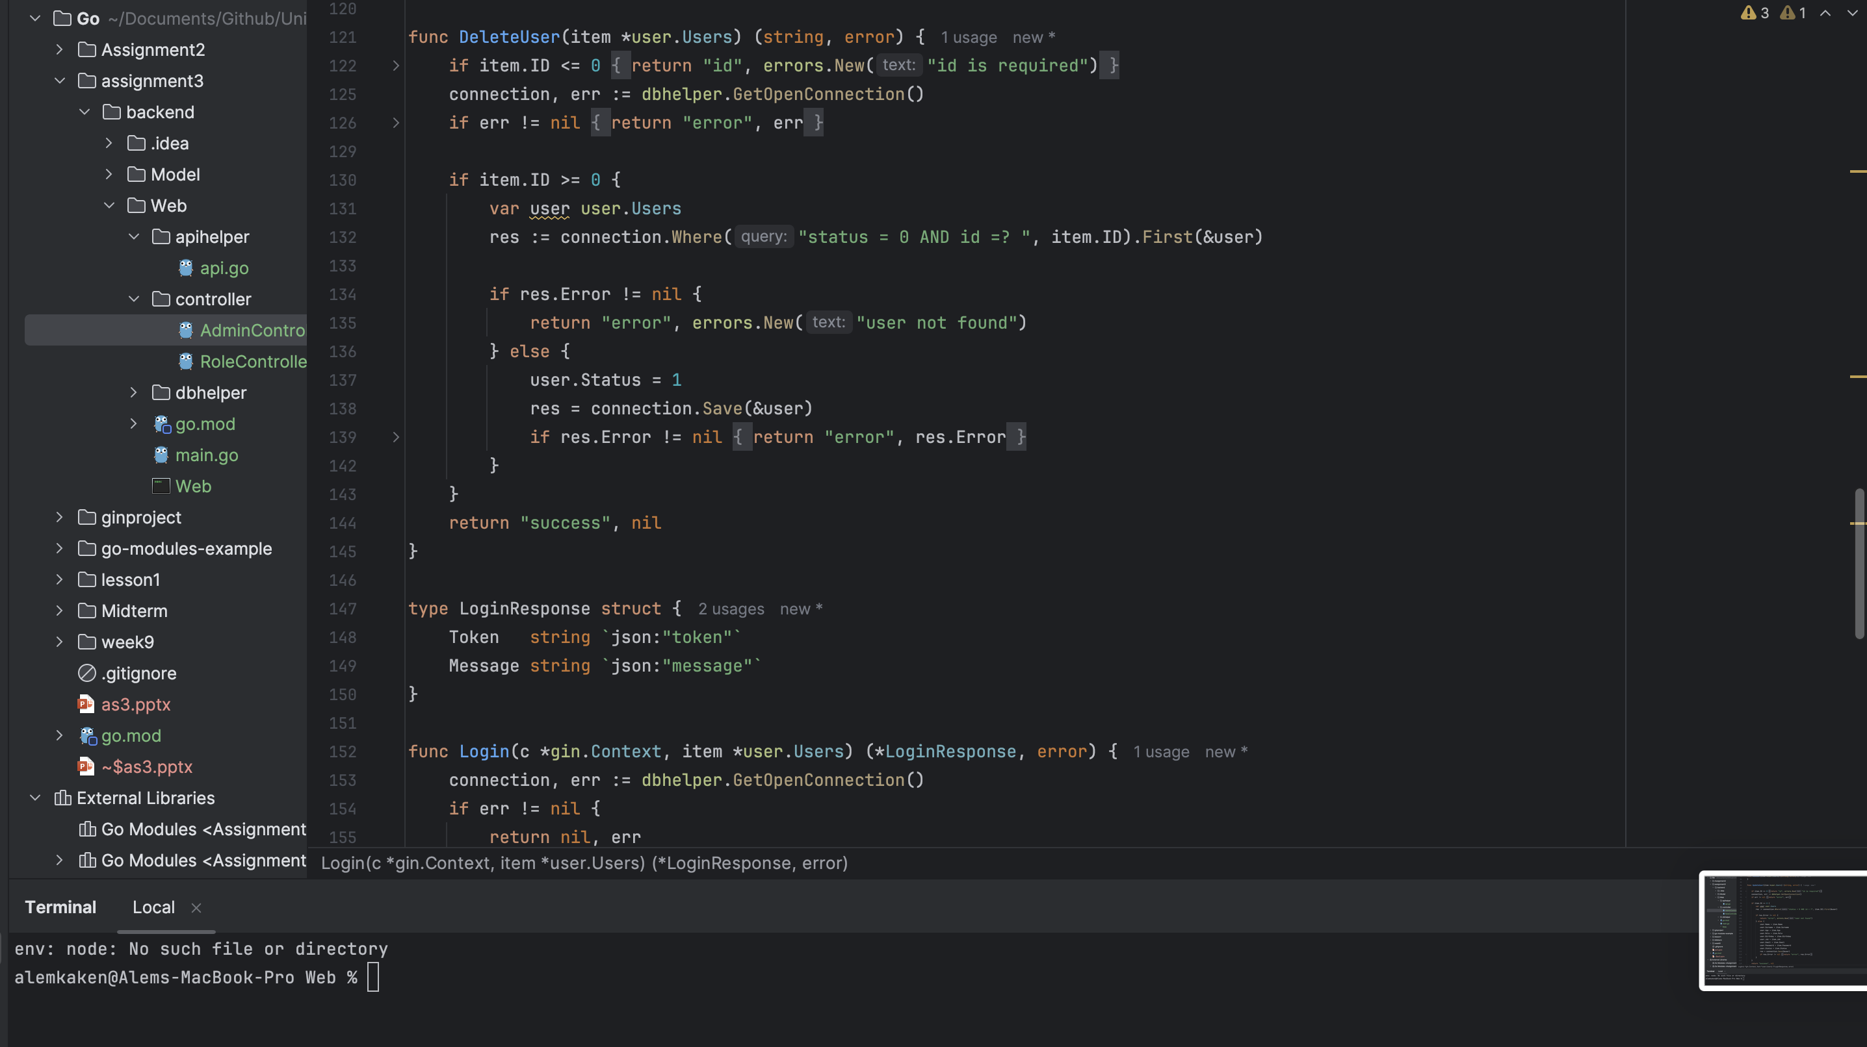
Change the admin's status according to the id to simulate deleting the user

Slide 9
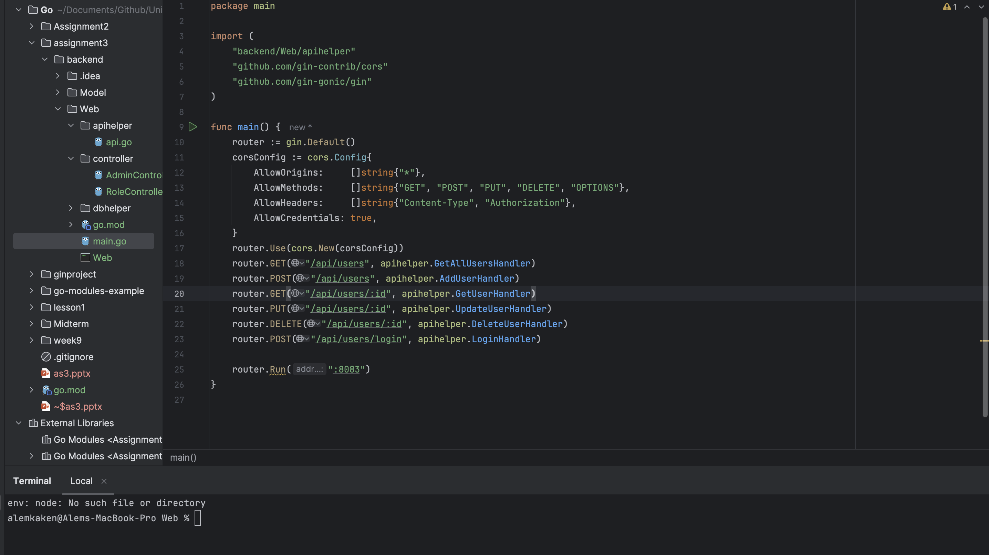
High Performance: Gin is extremely fast, thanks to its minimalistic design and use of httprouter, making it well-suited for building high-performance APIs. Easy to Use: Gin’s syntax is straightforward and developer-friendly, making it easier to learn and use, especially for creating RESTful APIs quickly. Middleware Support: It has robust middleware support, allowing developers to easily add logging, authentication, and error handling.

Slide 10
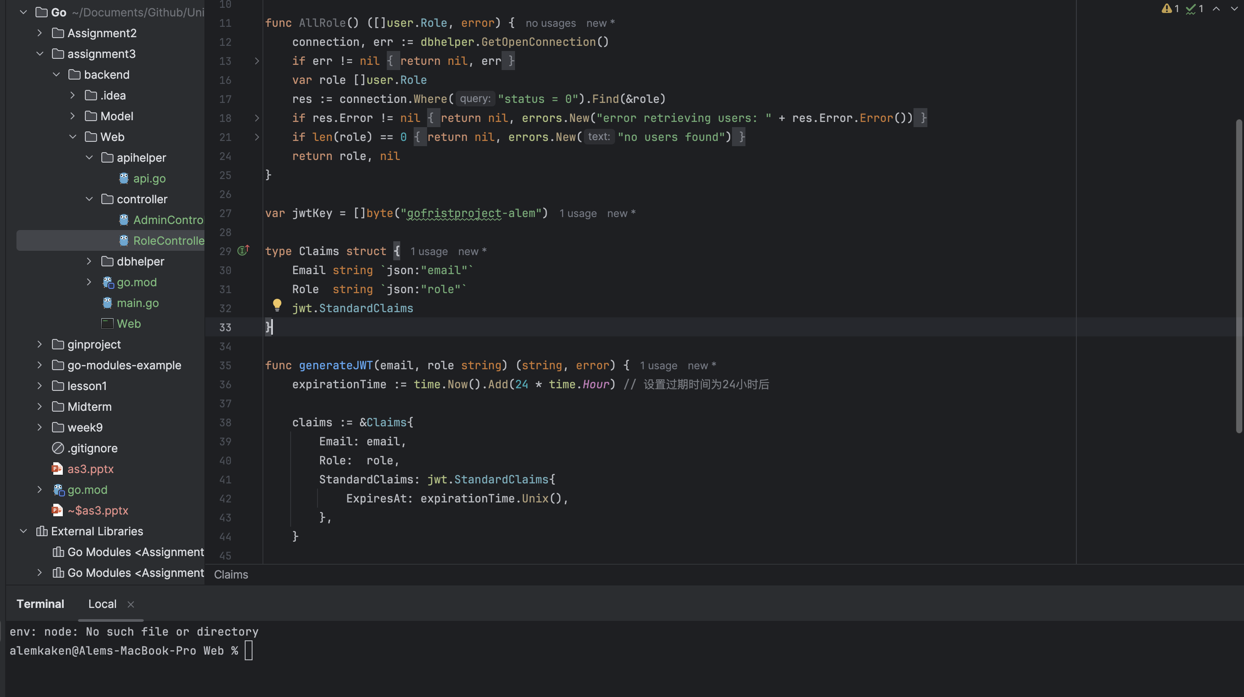
JWT tokens are self-contained, meaning they carry all necessary information (like user identity and expiration) within the token itself. This makes authentication stateless and removes the need for server-side session storage, making it easier to scale the application.

Slide 11
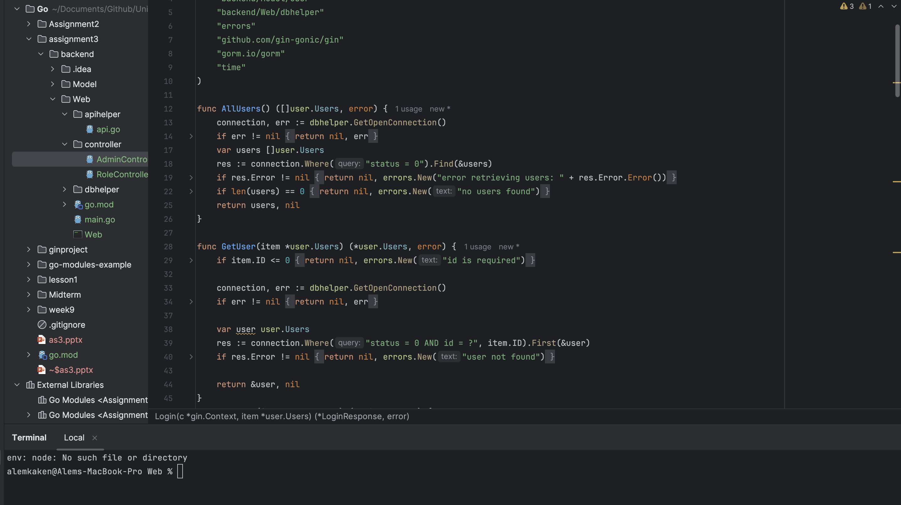
Get

Slide 12
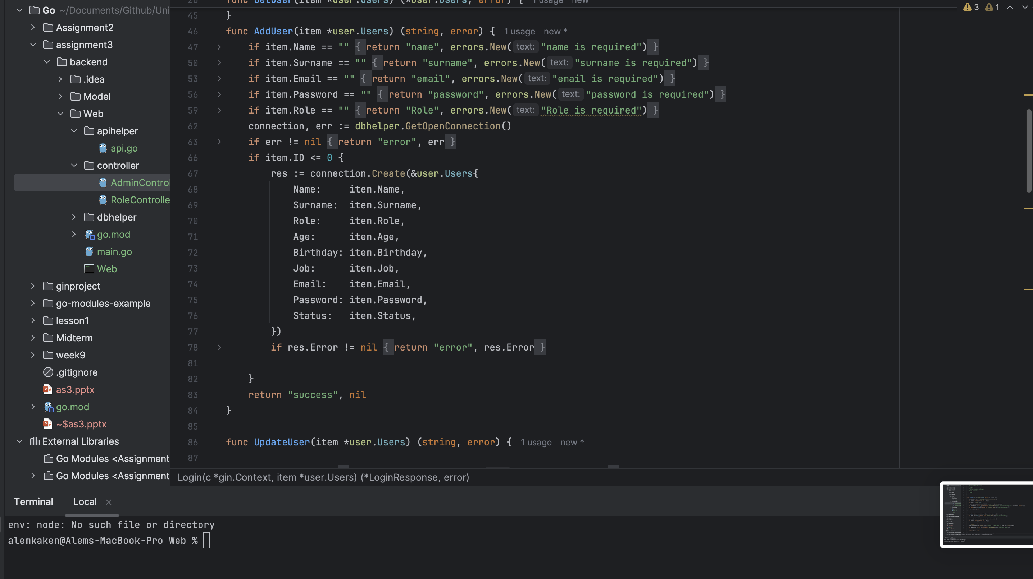
Add user

Slide 13
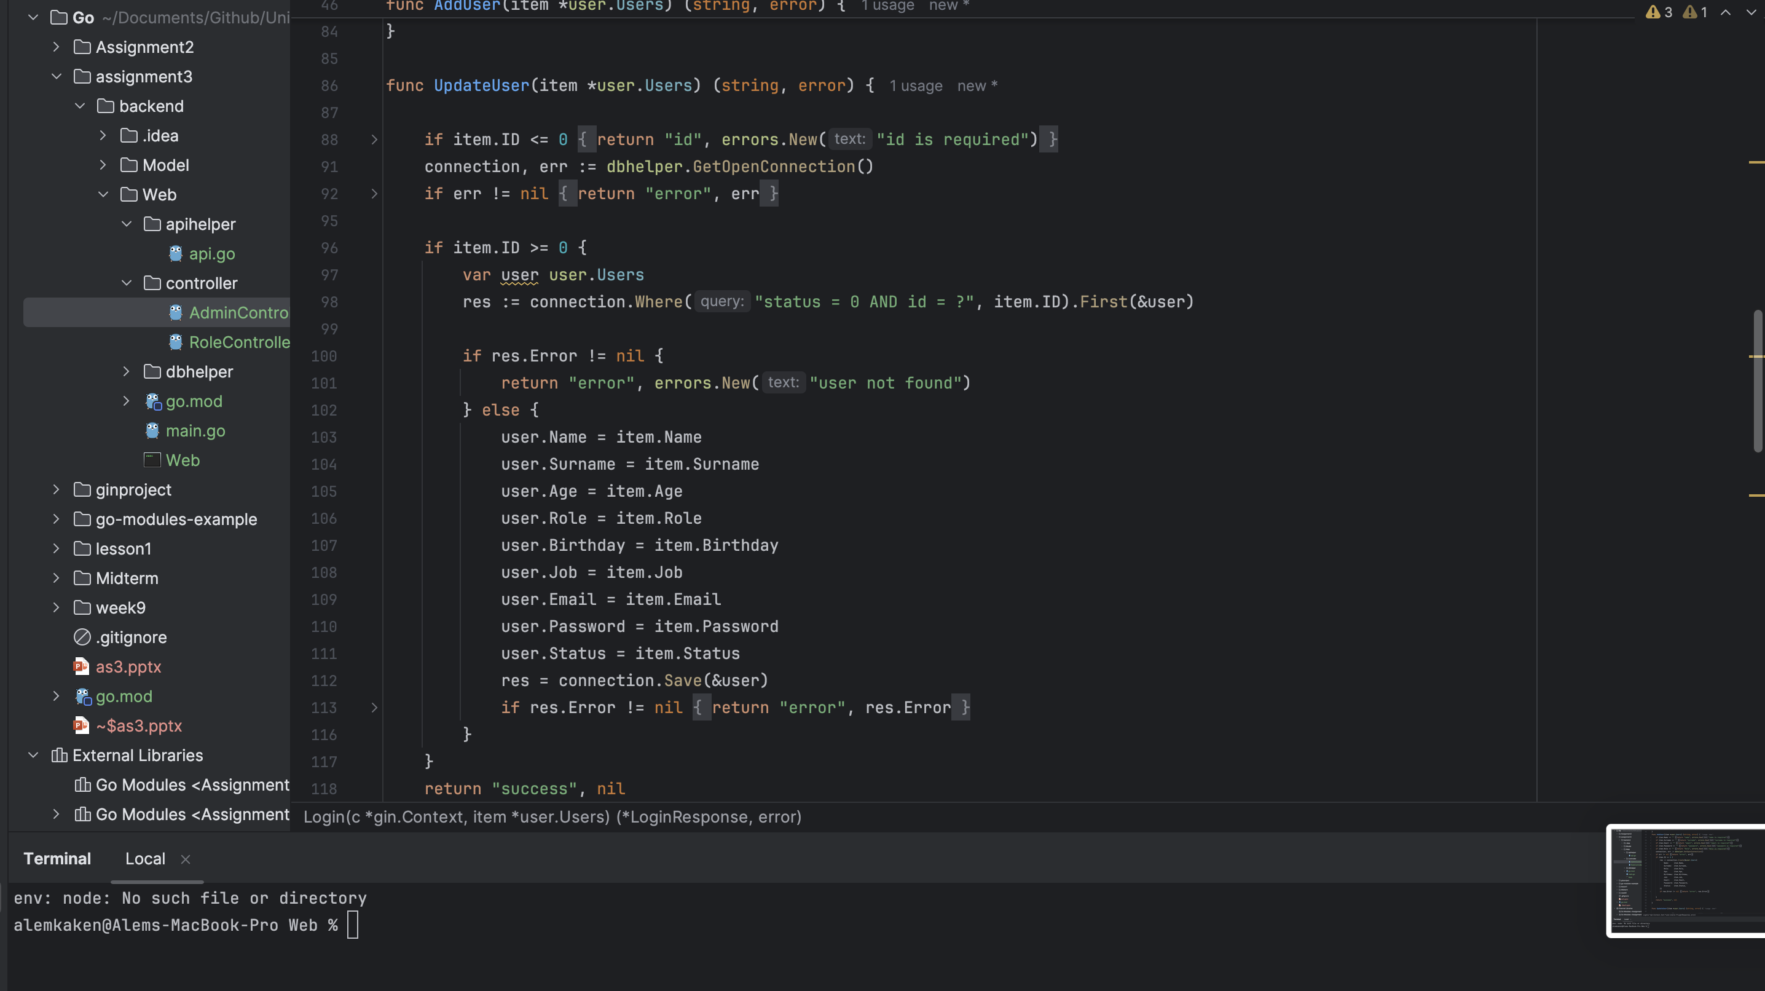
Update user

